Slide 1
Musical Elements 2
Kenny Lim

Slide 2
Key
Scales
Intervals
Tone Colour
Theme
Harmonies
Textures & Forms

Slide 3
Key
Tonality

Slide 4
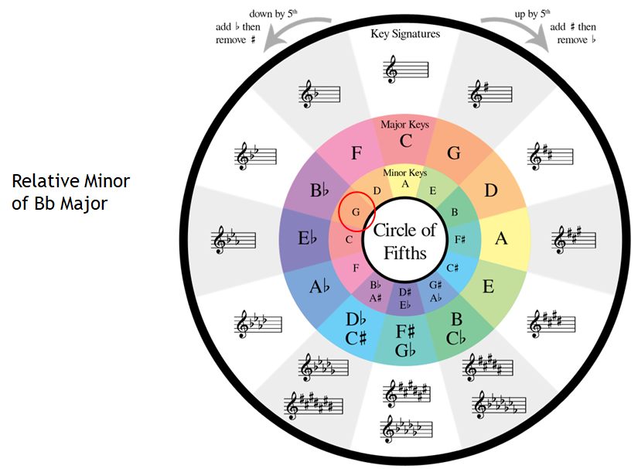
Keys: Circle of fifths

Slide 5
Scales
Series of notes based on a Key

Slide 6
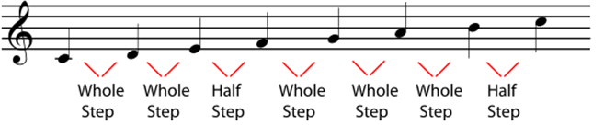

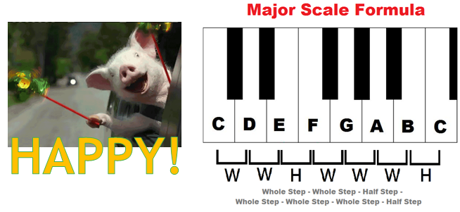
Major Scale

Slide 7
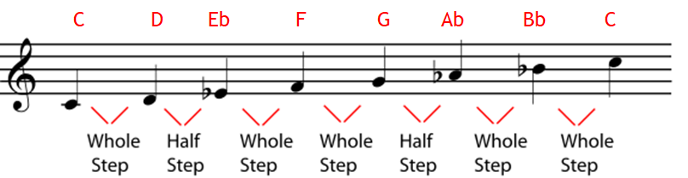
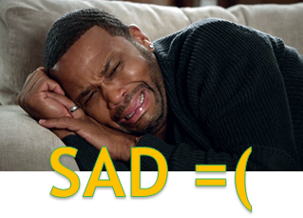
Minor Scale

Slide 8
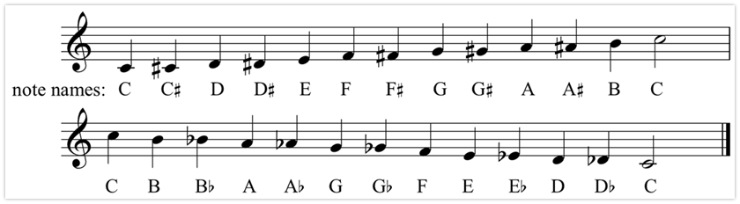
Chromatic Scales

Slide 9
Test your ears
1.

Slide 10


Is this Major/Minor/Chromatic scales?
ⓘ Start presenting to display the poll results on this slide.
Notes:
📣 This is Slido interaction slide, please don't delete it. ✅ Click on 'Present with Slido' and the poll will launch automatically when you get to this slide.

Slide 11
2

Slide 12
Is this Major/Minor/Chromatic scales?
ⓘ Start presenting to display the poll results on this slide.
Notes:
📣 This is Slido interaction slide, please don't delete it. ✅ Click on 'Present with Slido' and the poll will launch automatically when you get to this slide.

Slide 13
3

Slide 14
Is this Major/Minor/Chromatic scales?
ⓘ Start presenting to display the poll results on this slide.
Notes:
📣 This is Slido interaction slide, please don't delete it. ✅ Click on 'Present with Slido' and the poll will launch automatically when you get to this slide.

Slide 15
Modulation & Tonic Key
Tonic key is also known as the TONIC or HOME KEY.
MODULATION is when the TONIC KEY shifted away to another KEY.

Slide 16
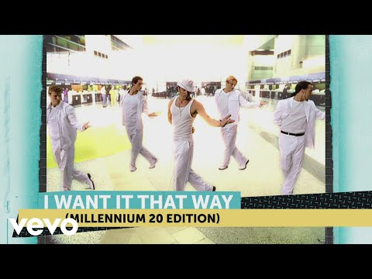

Slide 17

Can you hear the modulation?
ⓘ
Click Present with Slido or install our Chrome extension to activate this poll while presenting.
Notes:
📣 This is Slido interaction slide, please don't delete it. ✅ Click on 'Present with Slido' and the poll will launch automatically when you get to this slide.

Slide 18
Intervals
Distance between two pitch.

Slide 19
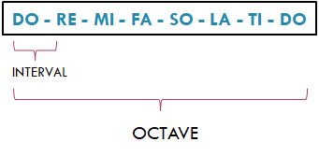

Slide 20
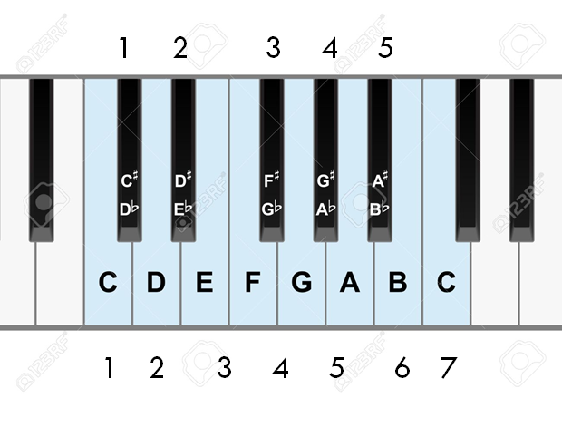
SEMITONE / HALF-STEP
Enharmonic notes
TONE / STEP
Notes:
- In western music pitch are separated in to 7 main tones, can anyone tell me what these tones are? Or sing them.
- Great, now when we talk about the distance between each tone we call them intervals, but when we talk about the distance between the same low and higher tone, we call them intervals.
#sing doremi

Slide 21


Leaps & Steps
Interval | Names
2nd | Major/ Minor 2nd
3rd | Major/ Minor 3rd
4th | Perfect 4th
5th | Perfect 5th
6th | Major/ Minor 6th
7th | Major/ Minor 7th
8th | Octave
Leap
Step

Slide 22
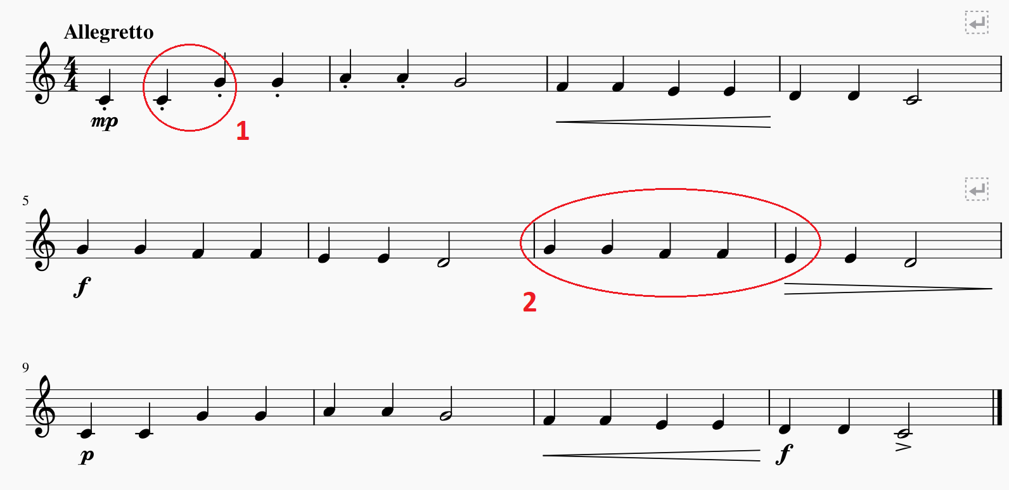
Let’s do some “analysis”!

Slide 23
Tone Color
Sometimes known as timbre

Slide 24
Tone Color
•The quality to distinguish different tones of different instrument is called tone color, OR timbre (pronounced tam’-ber)
•Tone color is described by words such as bright, dark, brilliant, mellow, and rich.
•Listening*
•Wagner Longherin (disc1, no.1)
•Stravinsky firebird (disc1, no.8)

Slide 25
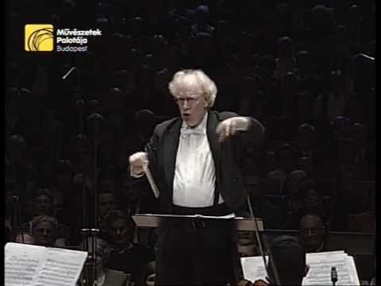

Slide 26

Describe the tone colour of this music.
ⓘ
Click Present with Slido or install our Chrome extension to activate this poll while presenting.
Notes:
📣 This is Slido interaction slide, please don't delete it. ✅ Click on 'Present with Slido' and the poll will launch automatically when you get to this slide.

Slide 27
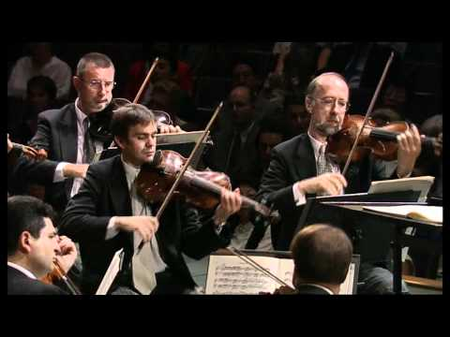

Slide 28
Describe the tone colour of this music.
ⓘ
Click Present with Slido or install our Chrome extension to activate this poll while presenting.
Notes:
📣 This is Slido interaction slide, please don't delete it. ✅ Click on 'Present with Slido' and the poll will launch automatically when you get to this slide.

Slide 29
Theme
Main materials in music

Slide 30
Theme
The musical material on which part or all of a work is based, usually having a recognizable melody and sometimes perceivable as a complete musical expression in itself, independent of the work to which it belongs. – grove music online
Theme can be recognizable through melody or rhythm

Slide 31


Slide 32
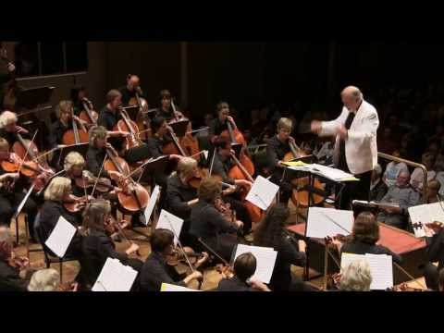

Slide 33
Harmony
Combination of tones

Slide 34
Topics
Chords
Key
Musical Textures
Musical Form techniques

Slide 35
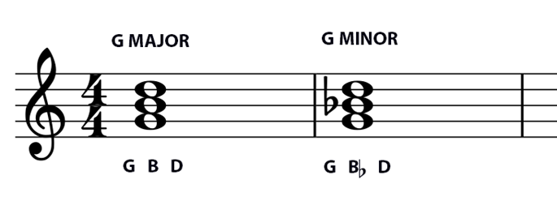
Chords: Triads
Combination of THREE or more tones sounded at once
Triads are the most basic chord, made up of alternate tones of the scale

Slide 36
Let’s use our voice to harmonise!

Slide 37
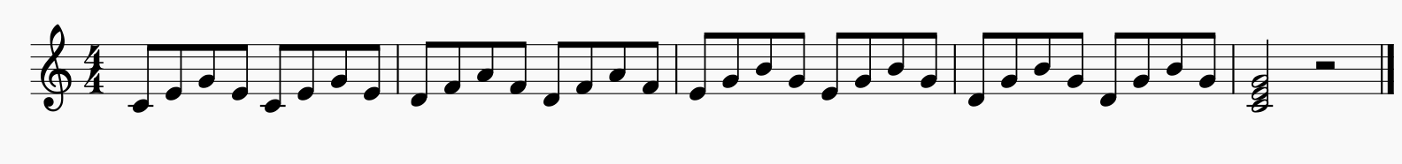
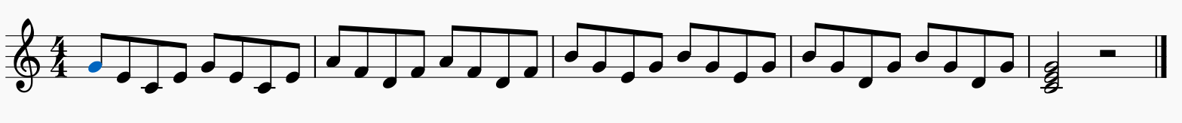
Broken Chords
Broken chords are when the individual tones of a chord are sounded one after another.

Slide 38
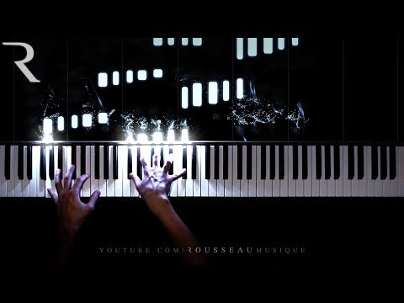

Slide 39
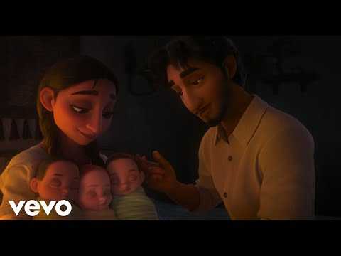

Slide 40
Consonance & Dissonance
Consonance is a tone combination that sounds stable.
Dissonance is a tone combination that sounds unstable.
Consonances are points of arrival, rest, and resolution.
A dissonance has its resolution when it moves to a consonance.
When a resolution is delayed or accomplished in unexpected ways, a drama, suspense, or surprise is created.

Slide 41
Textures & Form
Musical layerings & Structure

Slide 42
Musical Texture
Monophonic Texture
Single melodic line without accompaniment.
Polyphonic Texture
Simultaneous performance of two or more melodic lines of relatively equal interest.
Homophonic Texture
One melody accompanied (by chords).

Slide 43
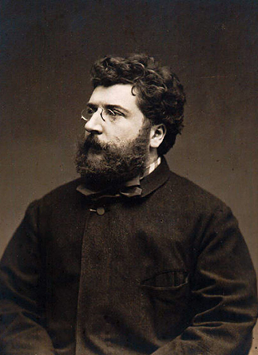
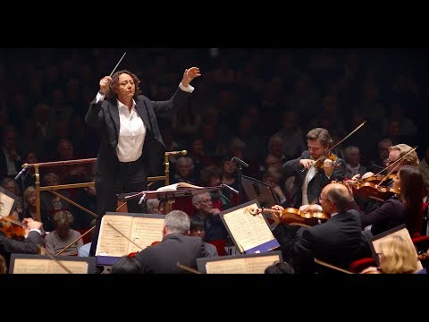
Listening
Bizet Farandole from L’Arlesienne Suite No.2

Slide 44
Basic Musical Form
Two-part (Binary) Form:
A (Statement) - B (Counterstatement)
Three-part (Ternary) Form:
A (Statement) - B (Contrast) - A (Return)
A
B
A
B
A

Slide 45
Musical Form
Techniques that create Musical Form:
Repetition - Creates a sense of unity
Contrast - Provides variety
Variation - Keeping some musical thought while changing others, gives a work unity and variety at the same time.

Slide 46


Slide 47

Audience Q&A Session
ⓘ
Click Present with Slido or install our Chrome extension to show live Q&A while presenting.
Notes:
📣 This is Slido interaction slide, please don't delete it. ✅ Click on 'Present with Slido' and the questions from your audience will appear when you get to this slide.

Slide 48
Topics throughout history
Middle Ages (450 - 1450) Renaissance (1450 - 1600) Baroque (1600 - 1750) Classical (1750 - 1820) Romantic (1820 - 1900) Twentieth Century to 1945 1945 onwards

Slide 49
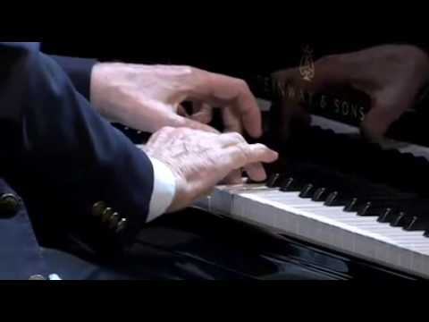

Slide 50

Have a great week ahead!

